Slide 1
DNE assignment 2
Modifying the attention mechanism of transformers for time series forecasting
Arne Lescrauwaet
Joachim Verschelde
Alexander Van Hecke

Slide 2
General context and setup
Elia solar power production dataset (timeseries data)
Actual measured power production
Day+1 forecasts
Research questions :
RQ1 : Can we do better than vanilla self-attention or causal convolution self-attention using a different attention mechanism?
RQ2 : Can a transformer architecture outperform the Elia prediction model (no details given about Elia model)

Slide 3
Steps taken
Data pre-processing
Aggregation (1day, 4 hours, 1 hour, 15 minutes)
Split in training (63%), validation (10%), test (27%) datasets
General quality checks => no data removed
Tune hyperparameters (validation dataset)
Limited computational resources!
Variations of layers, heads, forward expansion and kernel sizes
We chose a minimal set of hyperparameters (2 layers, 4 heads, 256 forward expansion) as this “was good enough”

Slide 4
Steps taken
Training - validation loop
Train the model with given parameters (training dataset)
Validate the model (validation dataset)
Early stopping implemented to limit computation
Keep all losses
Testing (test dataset)
Loop through test dataset once and accumulate losses
Perform statistics on all losses

Slide 5
Implementation details
Modular and composable transformer architecture from scratch
Only input encoding changes for the different attention mechanisms
Several blocks were implemented :
SelfAttention : generic self-attention mechanism
TransformerBlock : attention, normalisation, feed forward, dropout
TimeSeriesEncoder : base input encoder
4 specific implementations (base, causal convolution, right padded convolution, fourier)
TimeSeriesLinearDecoder : decoder
TimeSeriesTransformer : transformer with encoder + decoder

Slide 6
Implementation details : causal convolution
Enhancing the Locality and Breaking the Memory Bottleneck of Transformer on Time Series Forecasting
++ performance
Causal convolution

Slide 7
Implementation details : right padded convolution
Intuition :
Focus on the right hand side context of events in the attention mechanism
Implementation:
Sliding window
Kernel size

Slide 8
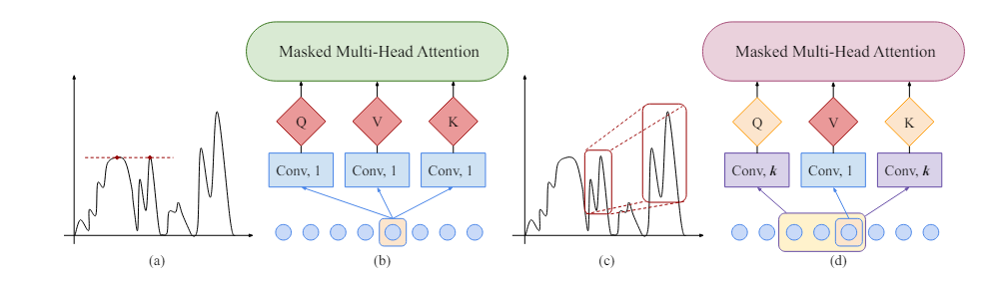
Implementation details : Attention with Fourier

Slide 9
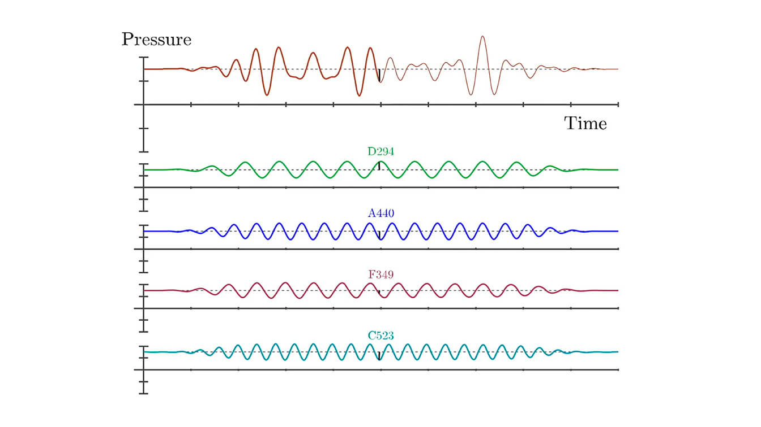
Implementation details : Attention with Fourier

Slide 10
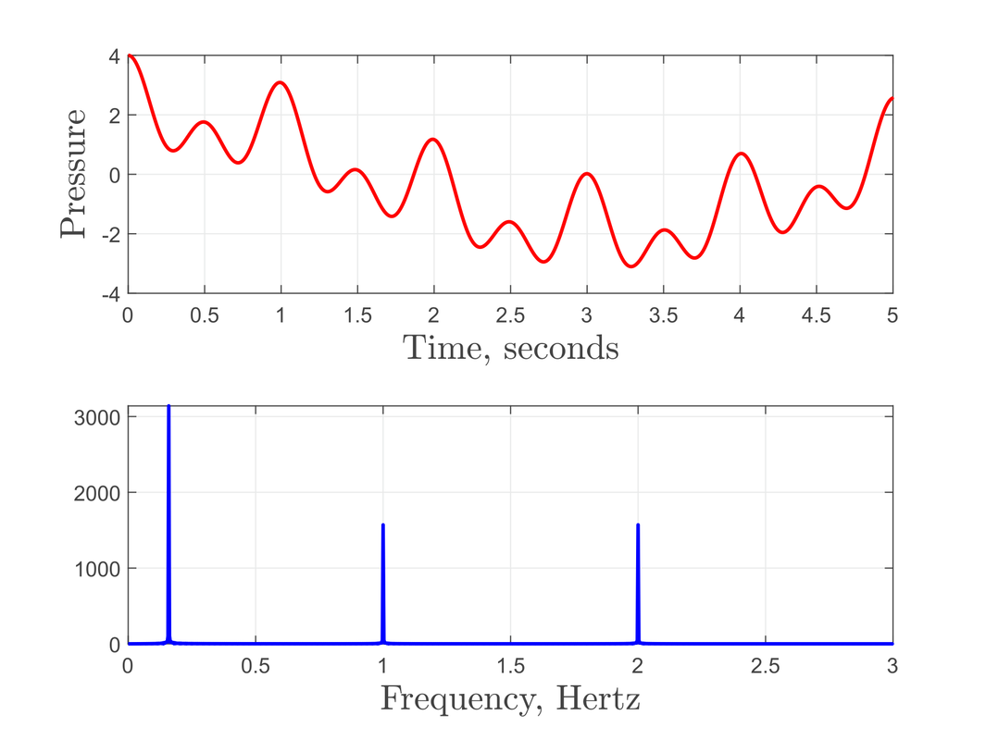
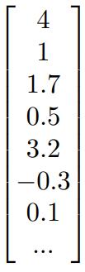
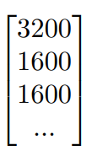
Implementation details : Attention with Fourier

Slide 11
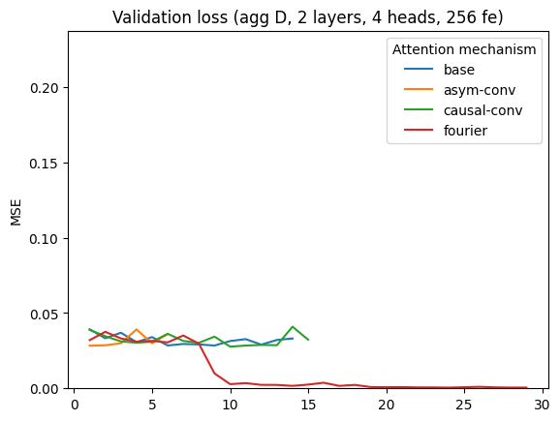
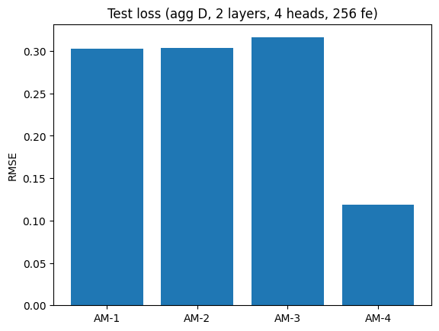
Results RQ1
Fourier is clearly the best mechanism for this particular dataset
Outperforms causal convolution 2.5x
Statistical validity checked using ANOVA and Tuckey HSD

Slide 12
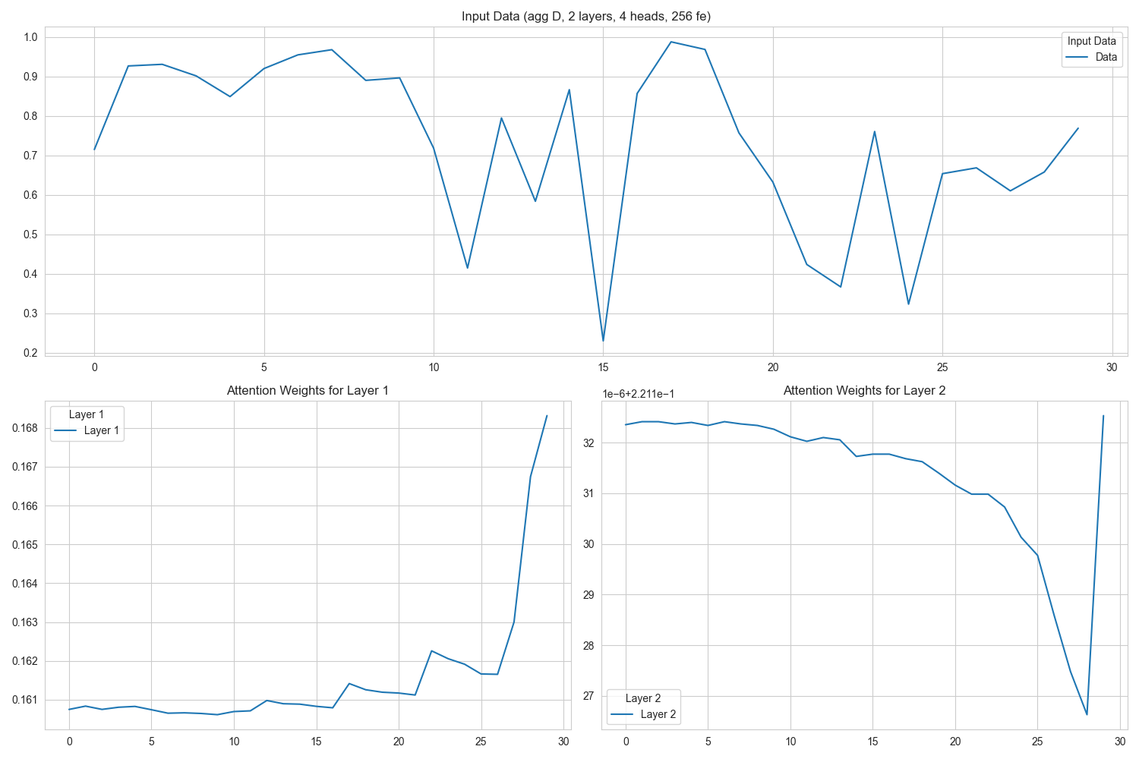
Visualizations AM-1
Results RQ1

Slide 13
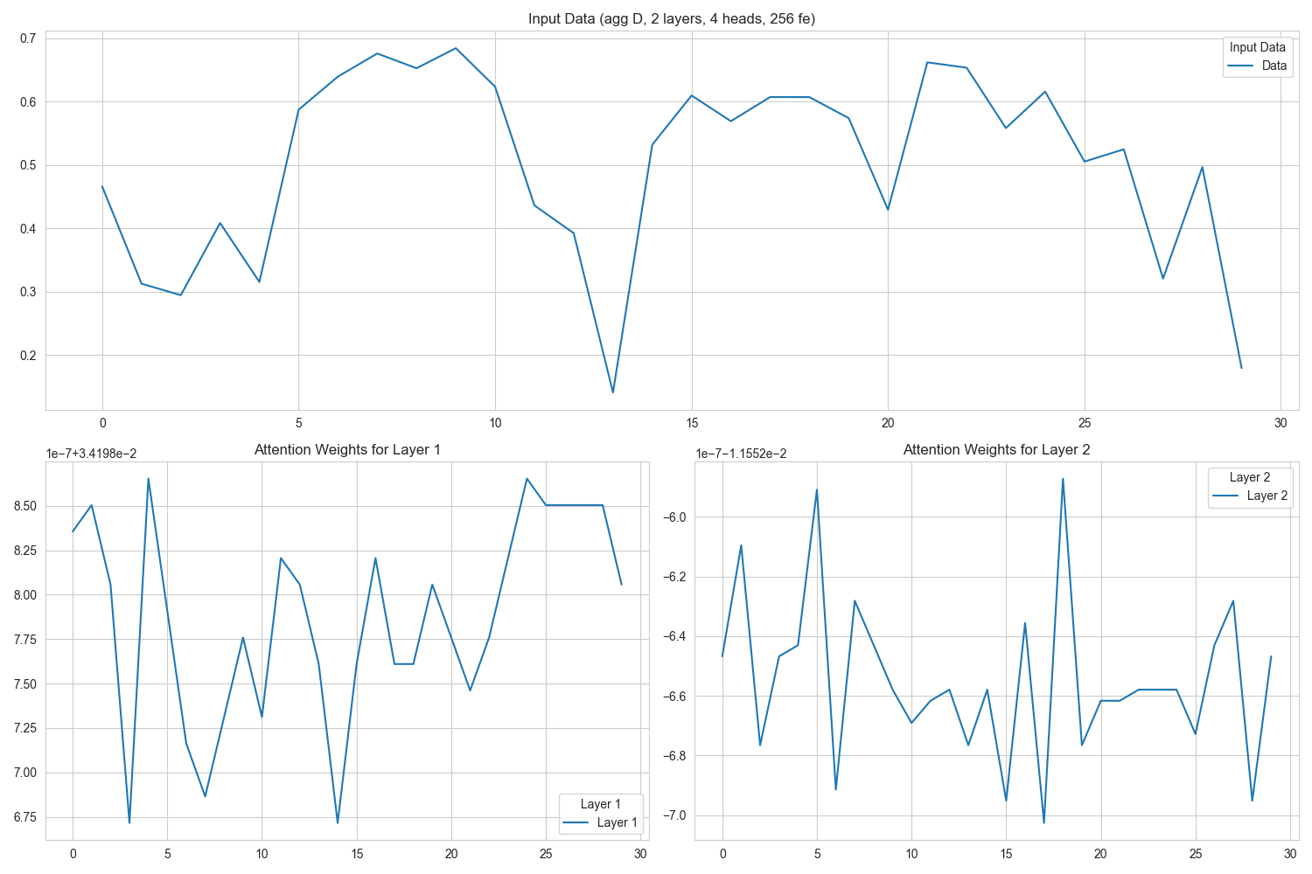
Visualizations AM-2

Slide 14
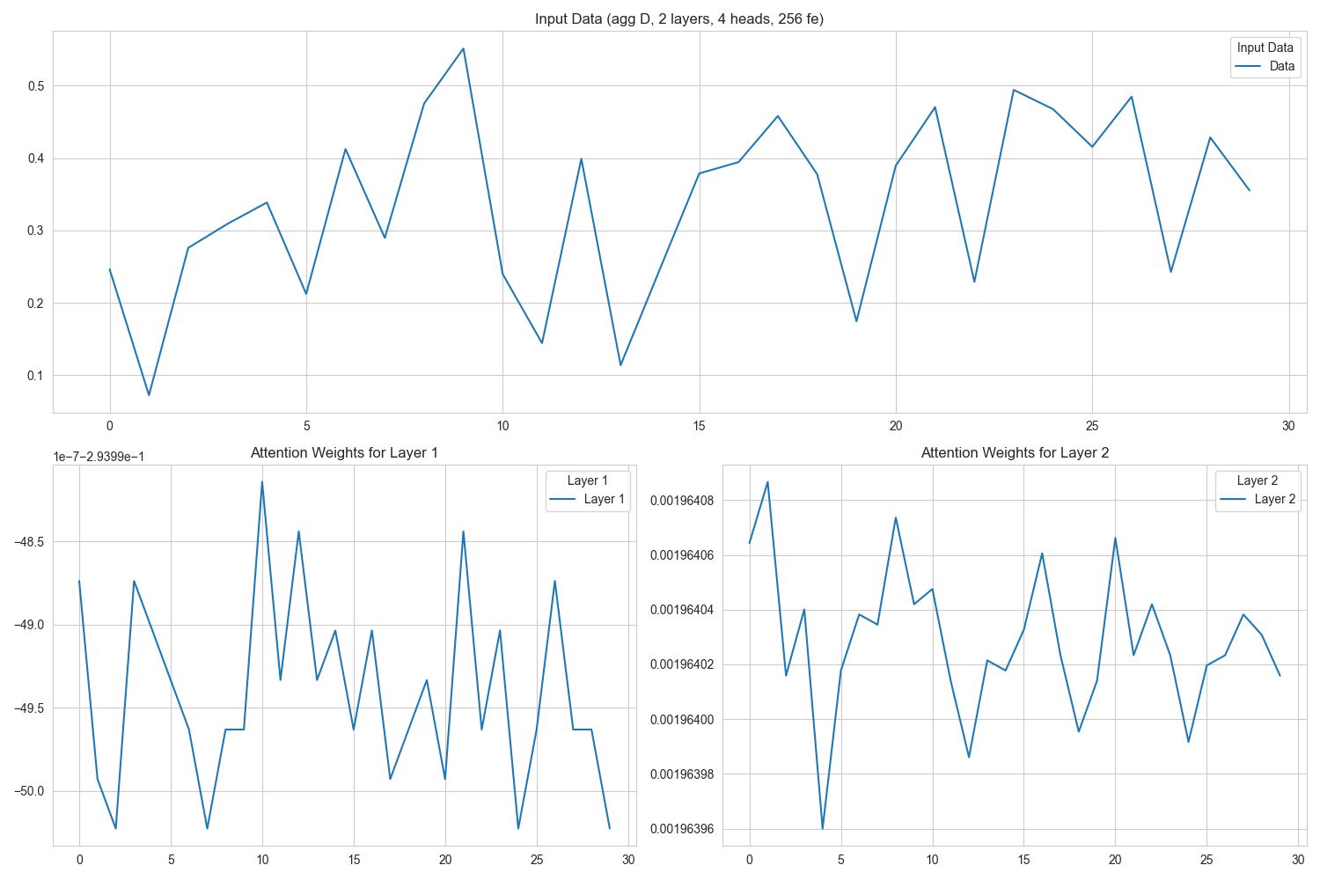
Visualizations AM-3

Slide 15
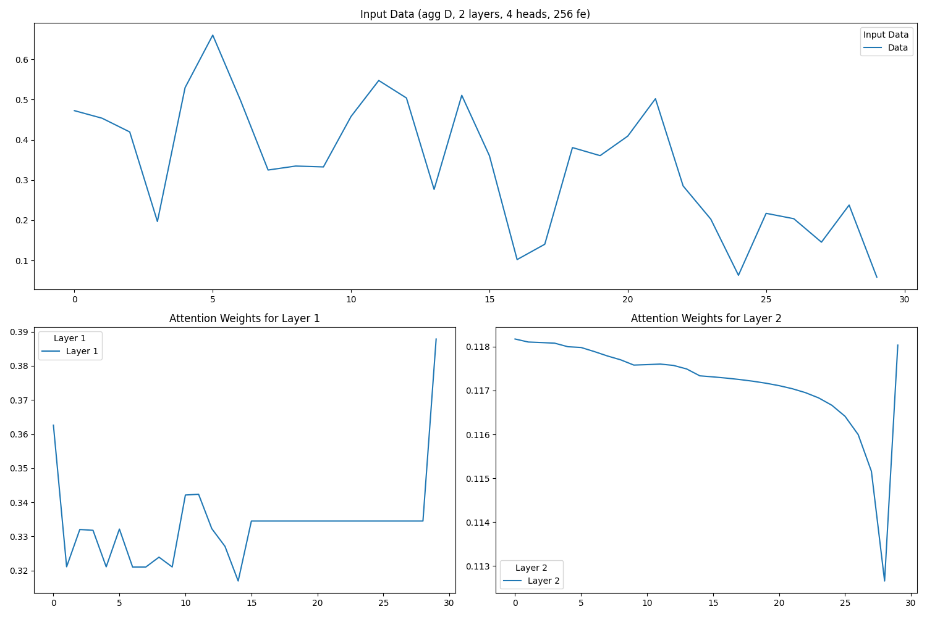
Visualizations AM-4

Slide 16
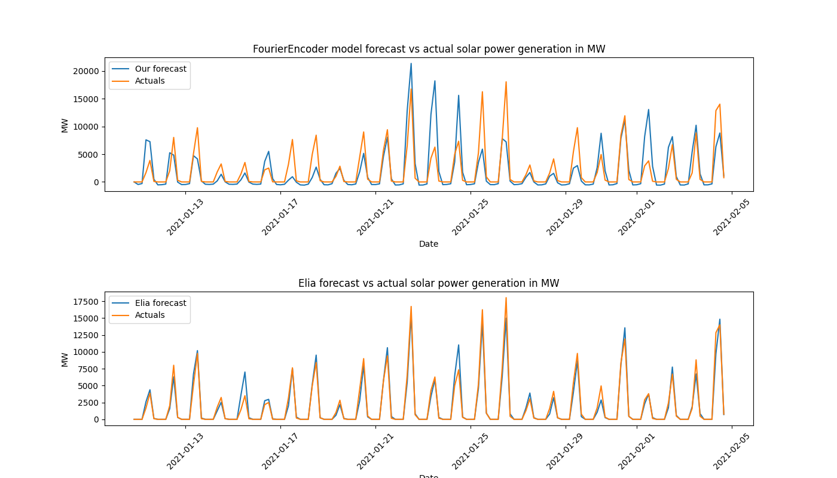
Results RQ2
Transformer model does not outperform Elia model
Limited computational resources
Limited number of epochs
Maturity of Elia model

Slide 17
Conclusions and future work
RQ1
Fourier yields good results on our testset
RQ2
Transformer model is not as good as Elia predictions
Future work
Evaluate on different types of datasets (e.g. stock prizes)
Use the fourier encoding in established transformer architectures

